Slide 1
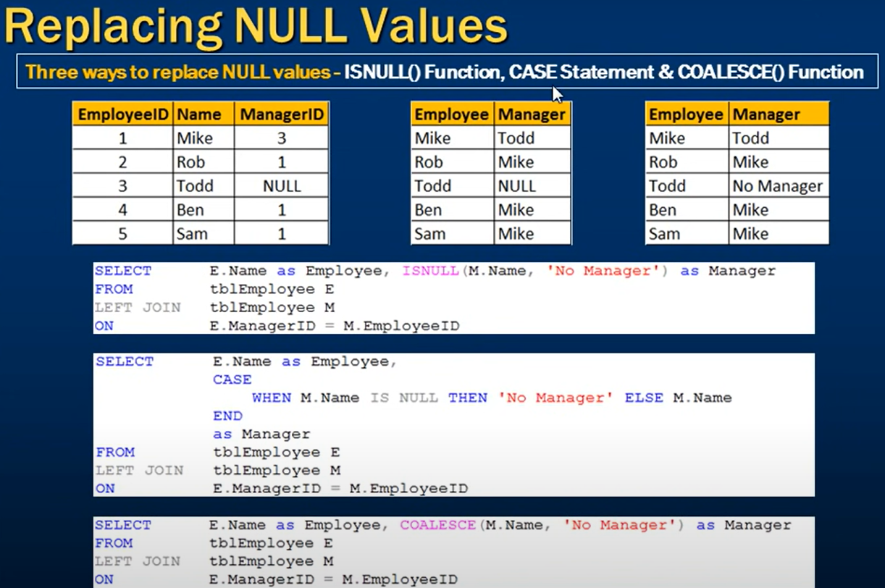

Slide 2
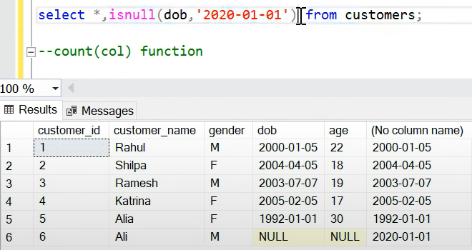
dob → datatype (date)
Datatype should be same otherwise it throughs error

Slide 3
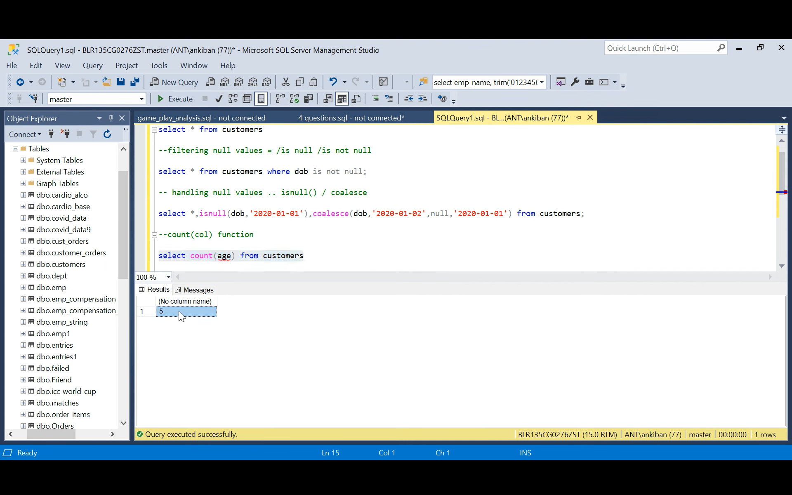
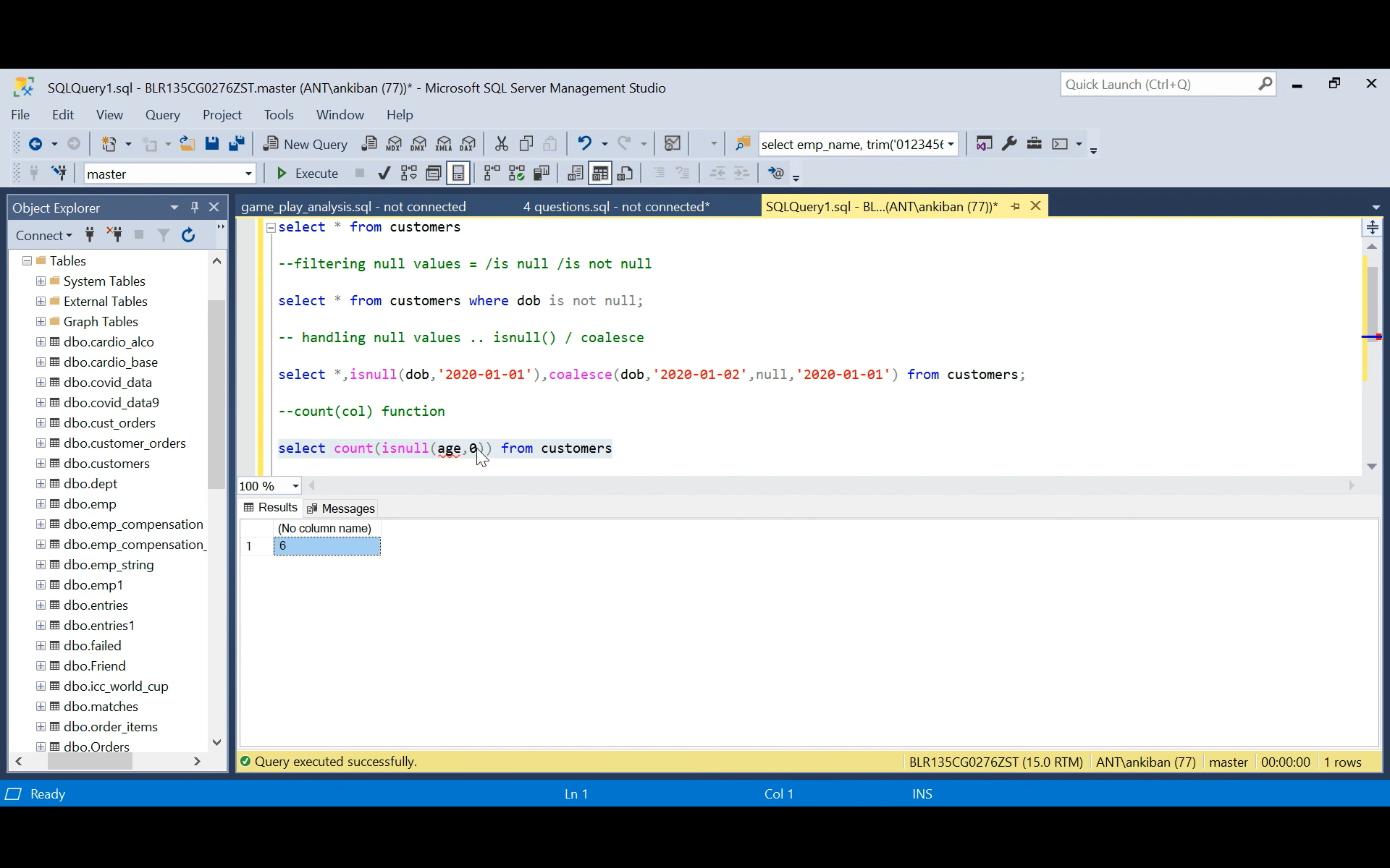

Slide 4
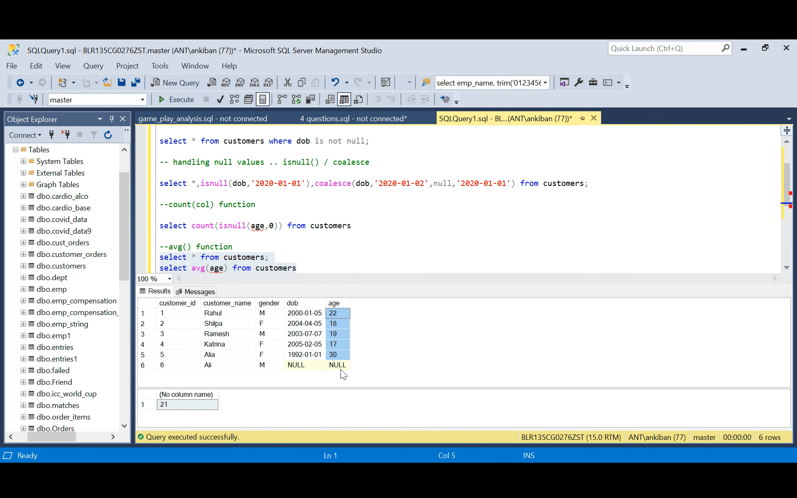
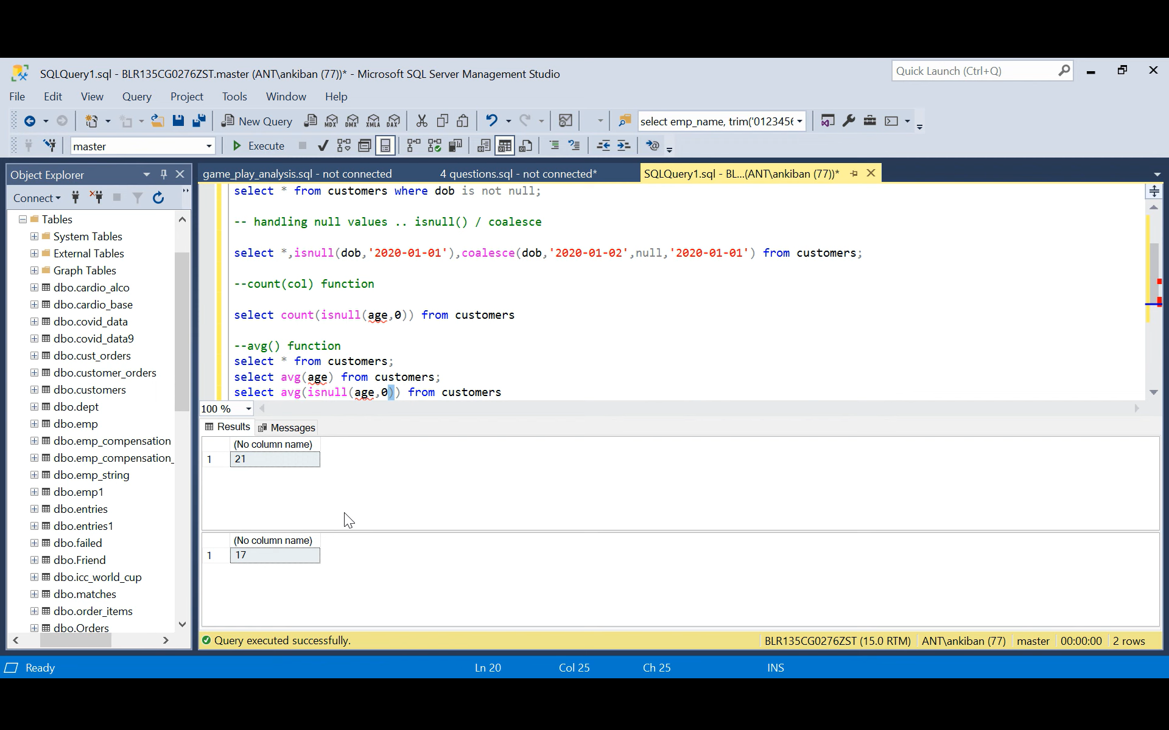
22+18+19+17+30 = 106/5 = 21
22+18+19+17+30 = 106/6 = 17

